Slide 1
Stochastic Multi-Label Image-to-image Translation (SMIT)​

Slide 2
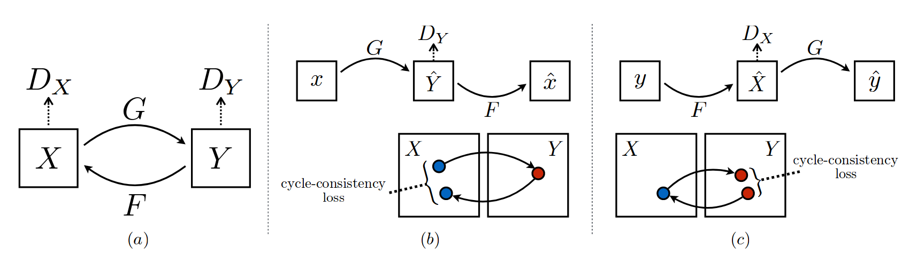
Image-to-Image Translation (CycleGAN)

Slide 3
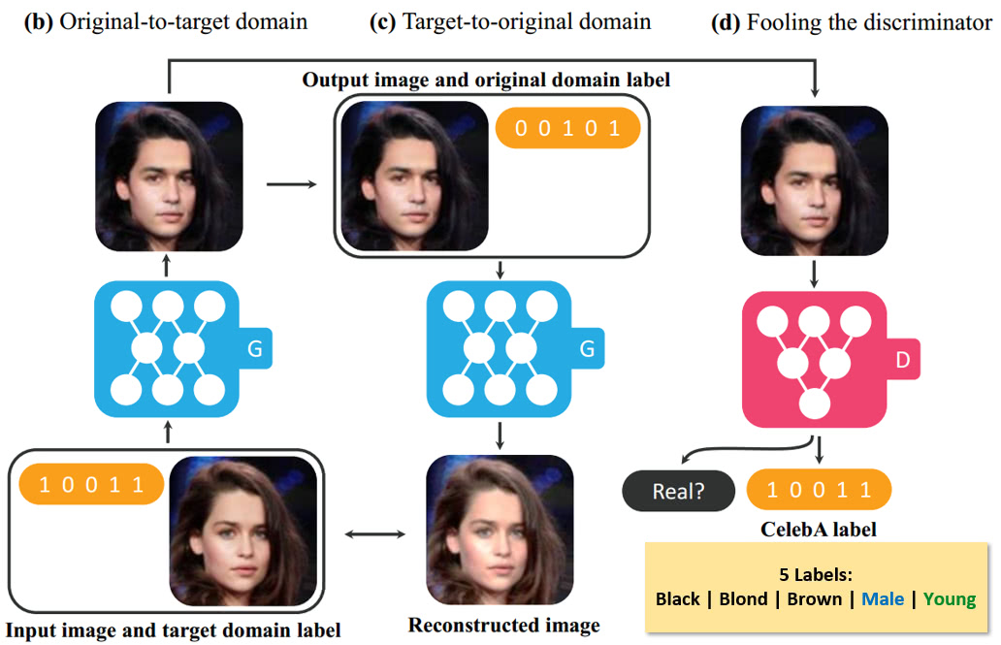
Multi-label I2I Translation (StarGAN)

Slide 4
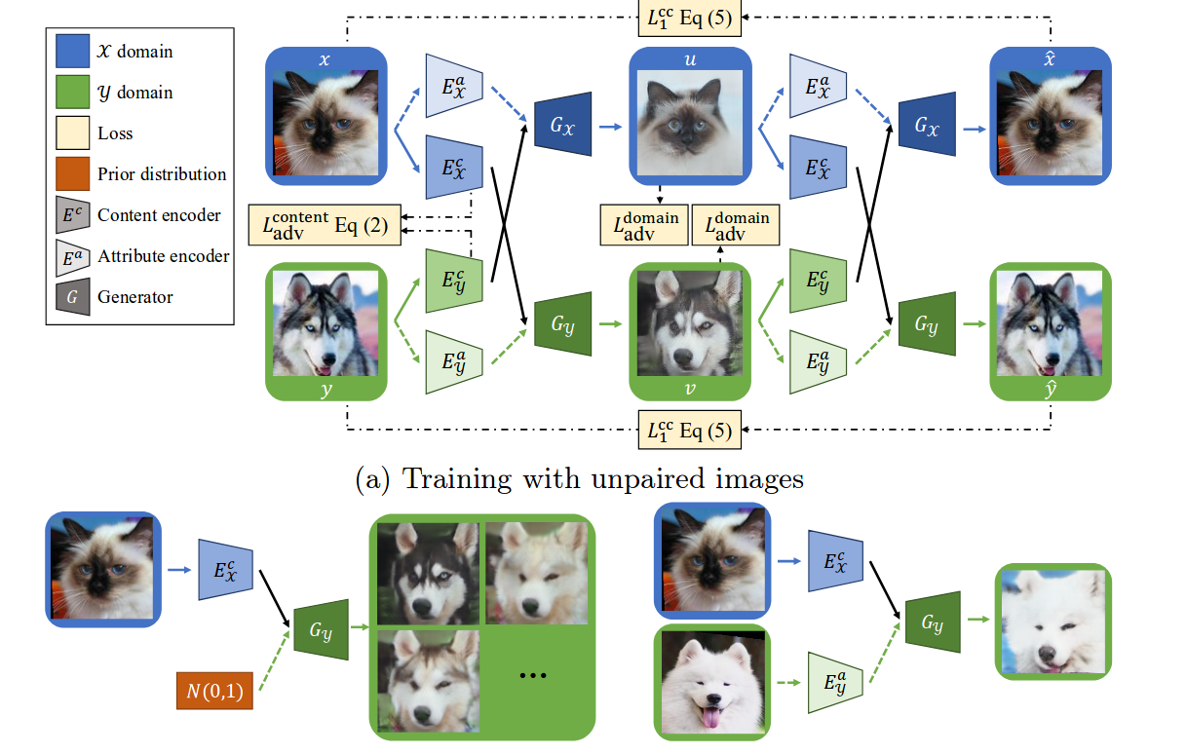
Multimodal I2I Translation (MUNIT, DRIT)

Slide 5
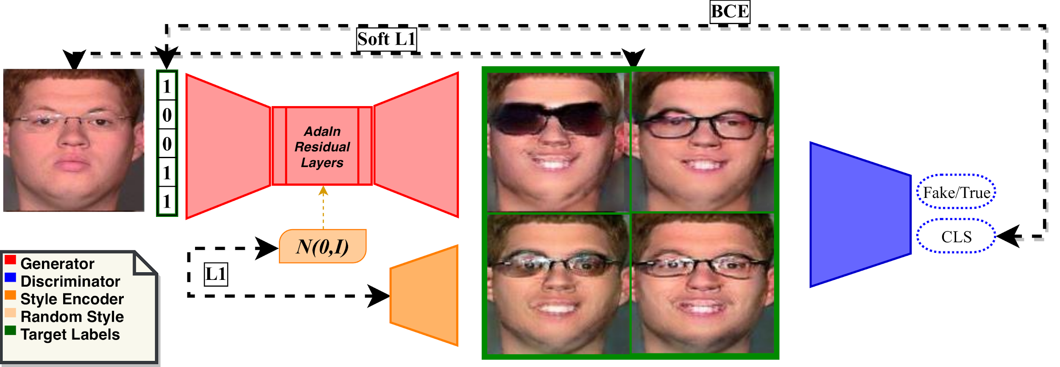
SMIT

Slide 6
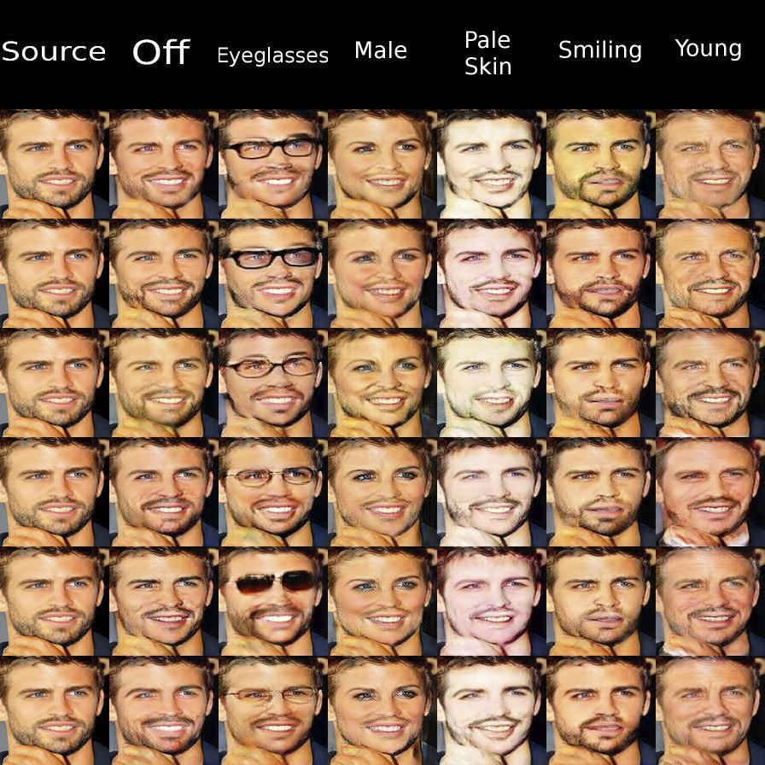
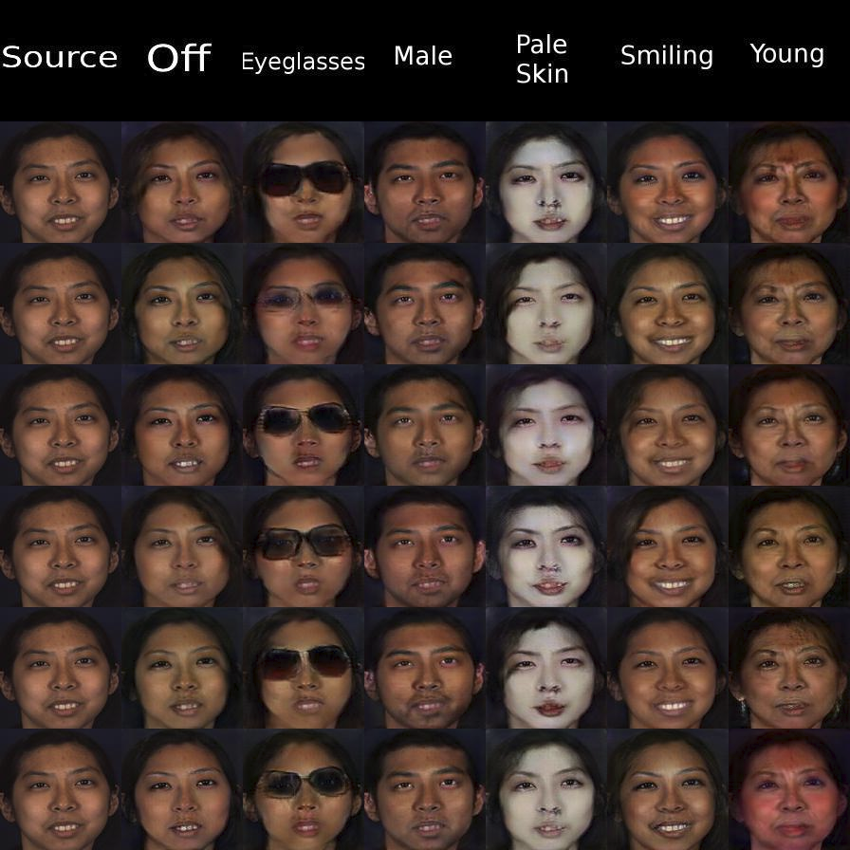
Results

Slide 7
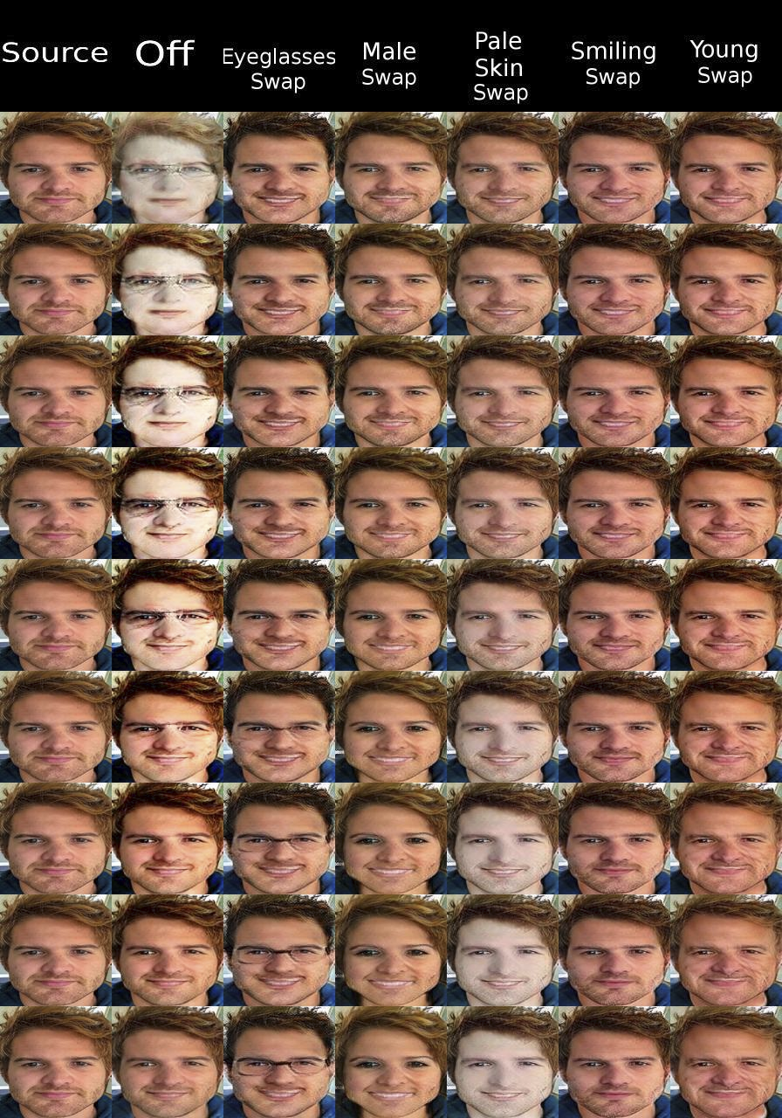
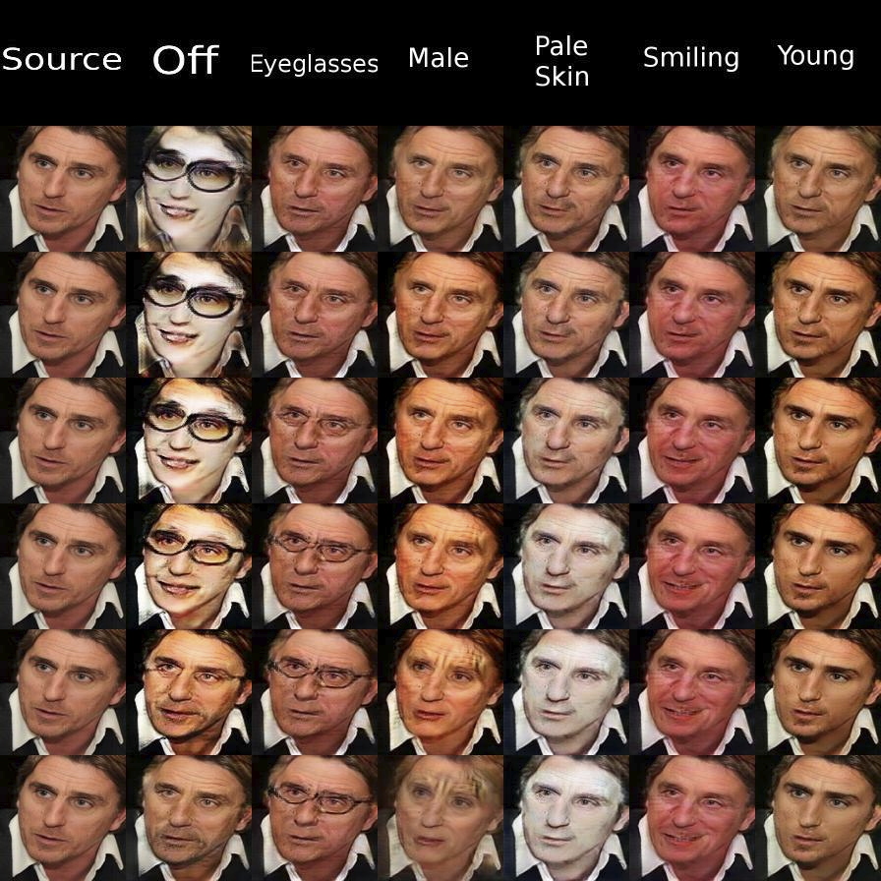
Continuous inference

Slide 8
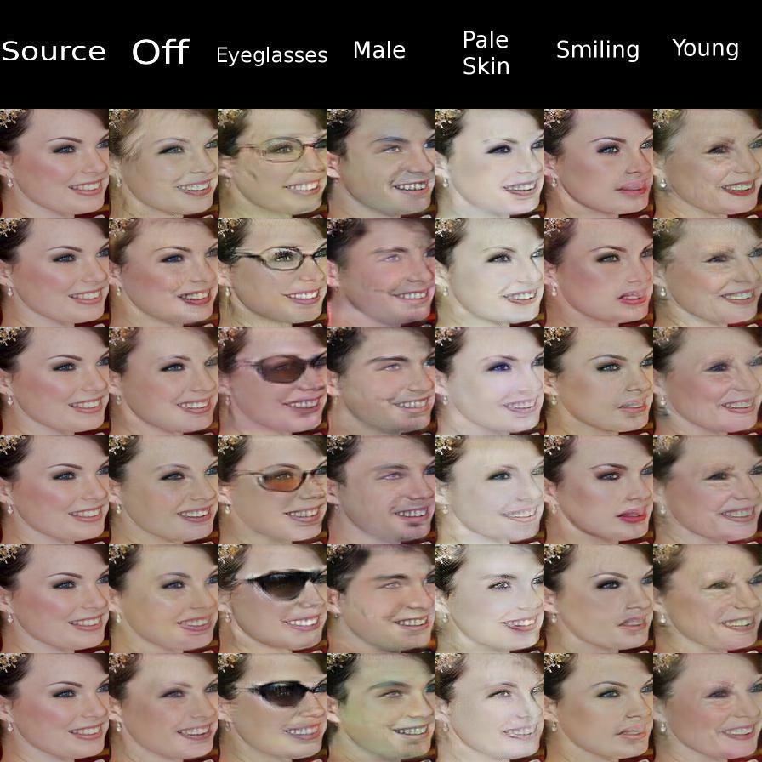
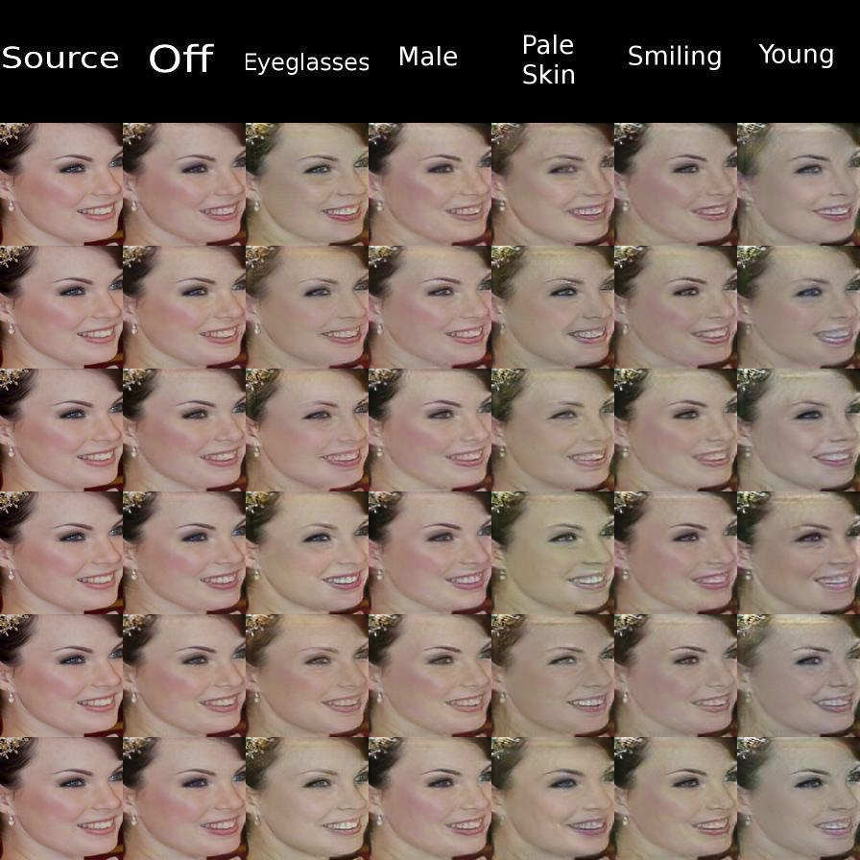
Translating and Recovering

Slide 9
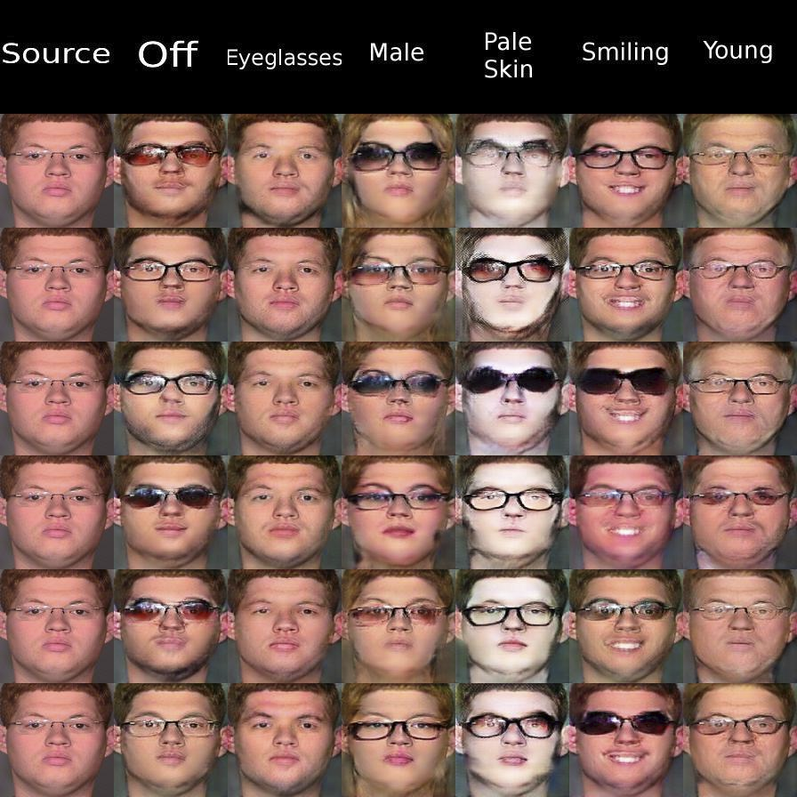
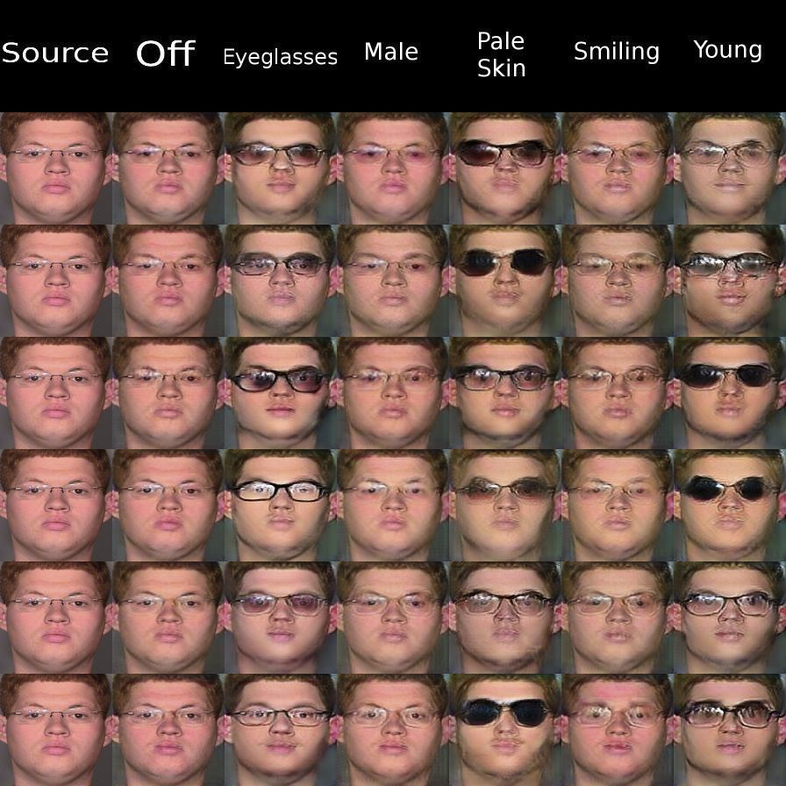
Translating and Recovering

Slide 10
I need your help
What other visualizations?
No more faces (different dataset).
Is it worth it in your problem?

